Slide 1
Tutorial of Deep Learning
黃俊傑(Huang Chun Chieh)
waheroc06119@hotmail.com

Slide 2
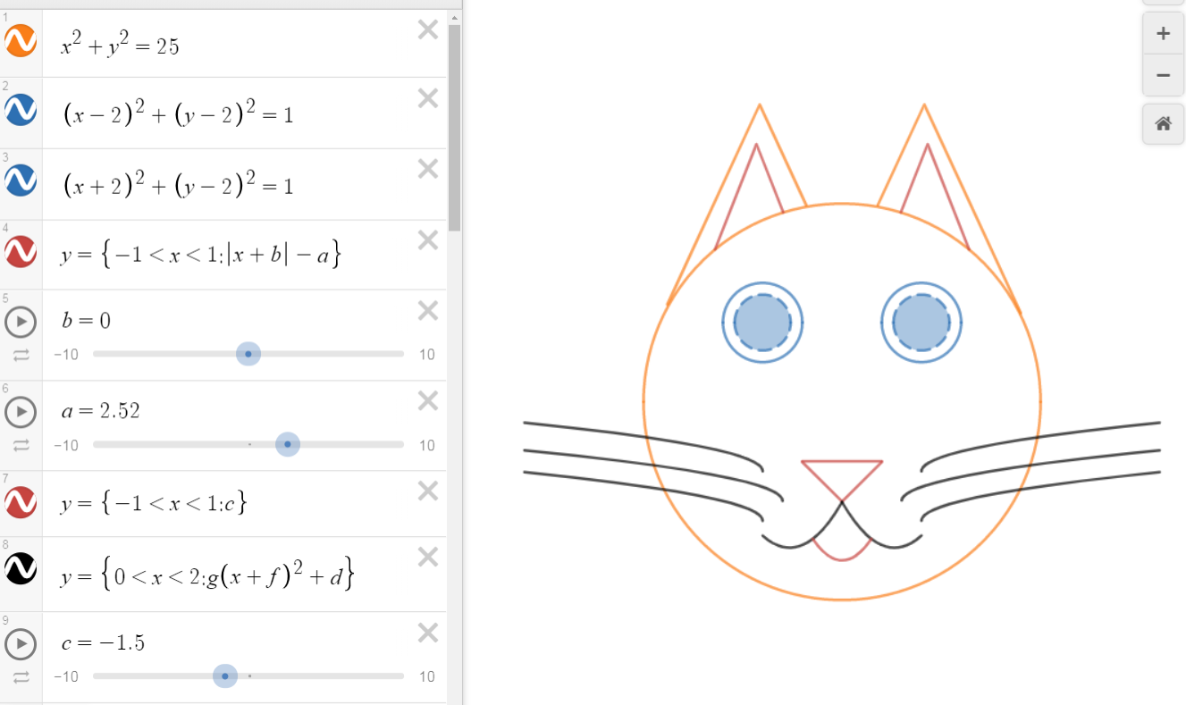
Introduction
Sample
人類想出來的演算法
Result
Extractor
Classifier
Sample
人類想出的來的特徵向量
(SHIFT, HOG... etc)
Machine leaarning
(SVM, KNN)
Machine learning → 具有可解釋性
Deep learning → 基本上不可解釋
Result
Deep learning
(Neural Network)
Sample
Result

Slide 3
Artificial Neural Network

Slide 4
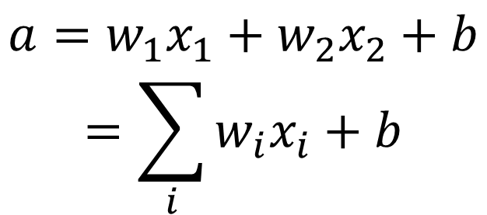
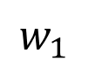
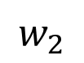
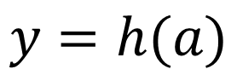
Artificial Neural Network
Hidden Layer
$$a=w_{1}x_{1}+w_{2}x_{2}+b$$
$$=\sum_{i}{w_{i}x_{i}+b}$$
bias
1
x₁
$$w_{1}$$
h(a)
a
y
$$w_{2}$$
$$y=h(a)$$
x₂
Notes:
bias

Slide 5
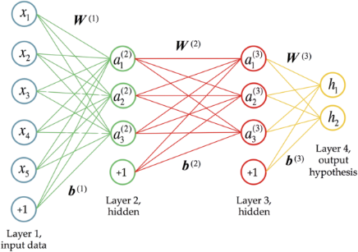
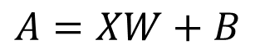
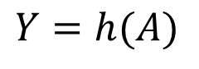
Forward Propagation
$$A=XW+B$$
$$Y=h(A)$$

Slide 6
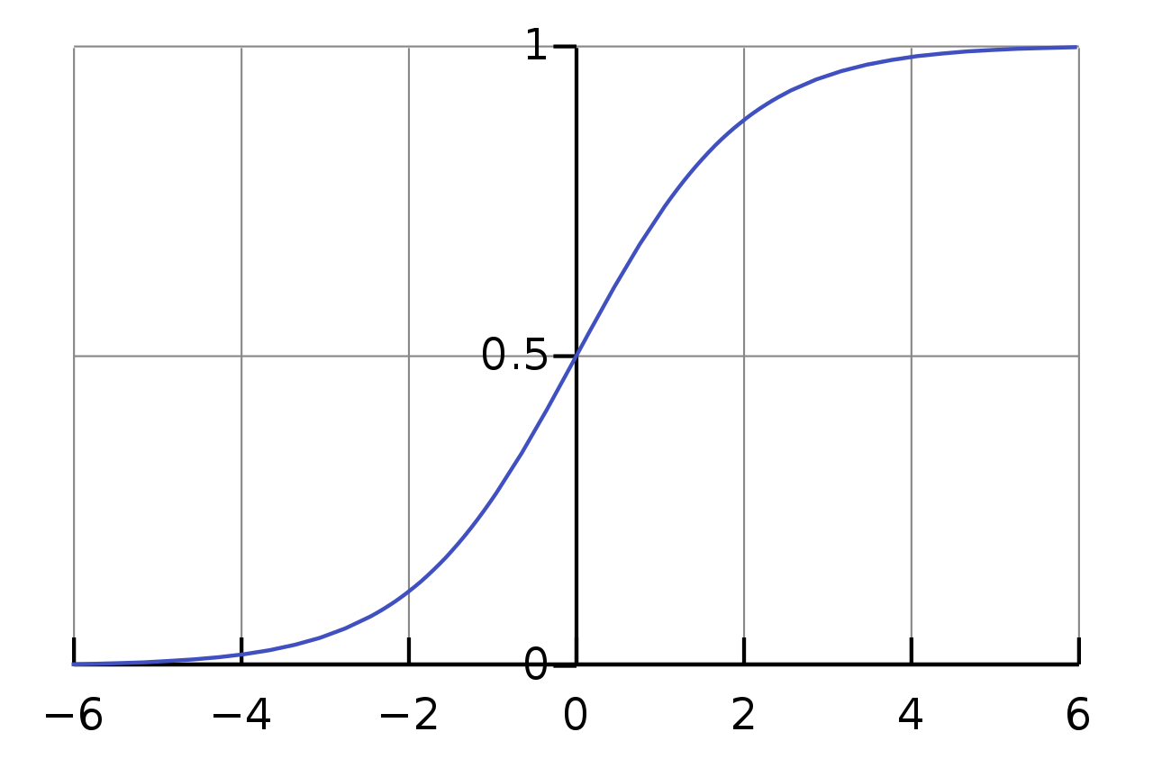
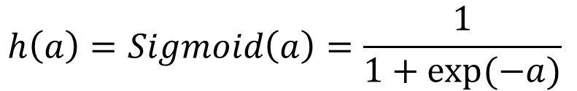
Activation function
Sigmoid
非線性轉換
$$h\left(a\right)=Sigmoid\left(a\right)=\frac{1}{1+exp⁡(−a)}$$

Slide 7
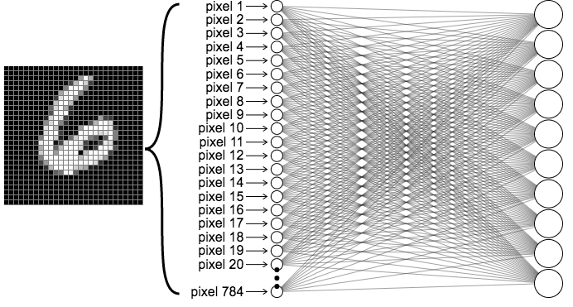
Output Layer
0
1
2
3
4
5
6
7
8
9

Slide 8
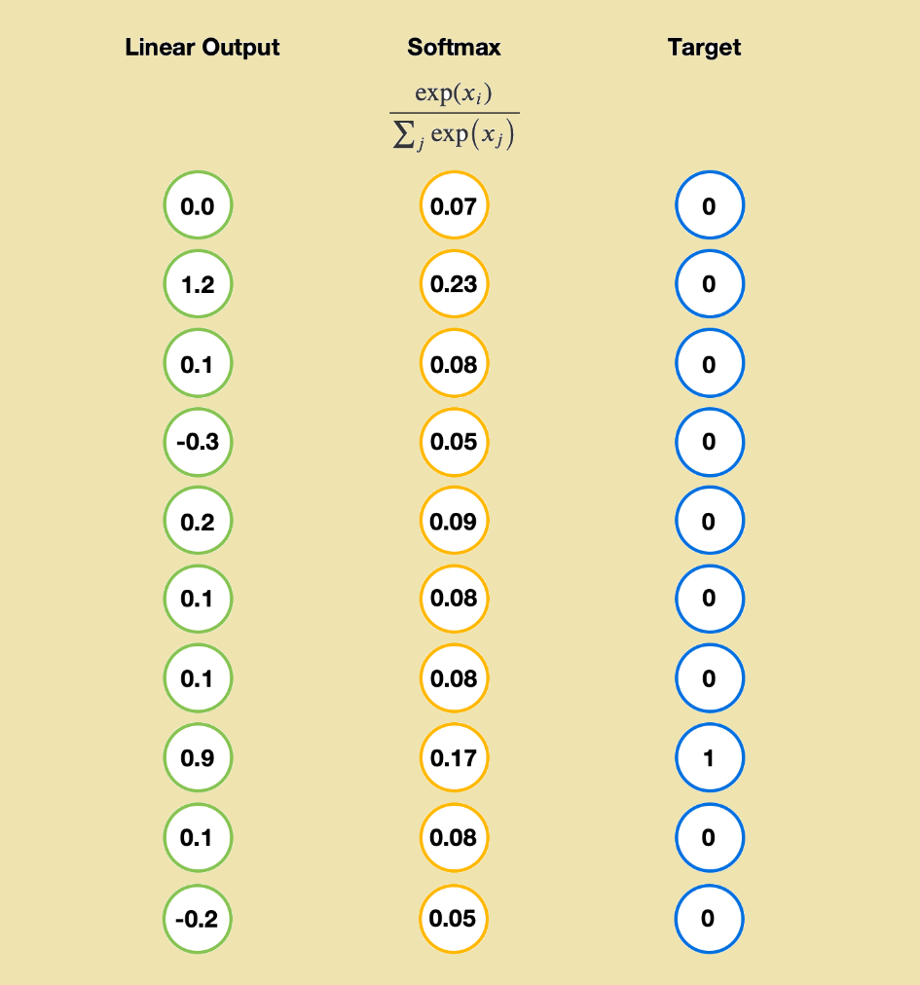
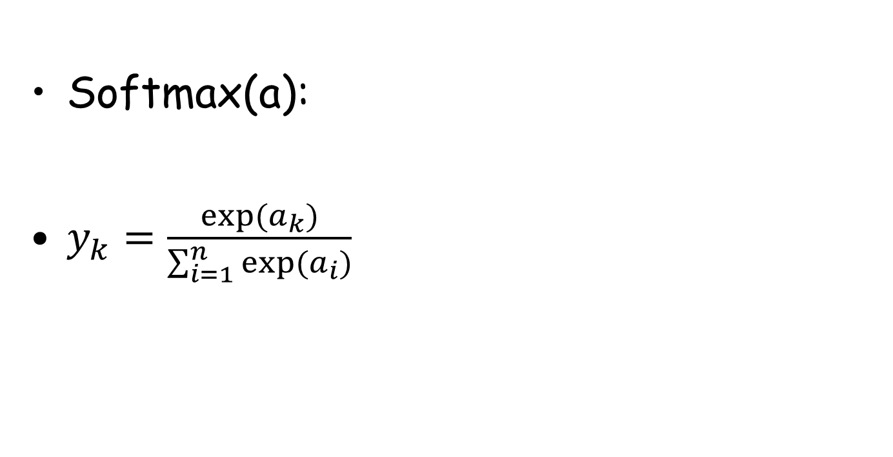
Output Layer
h(a)
a
y
Softmax(a):
$y_{k}=\frac{exp⁡(a_{k})}{\sum_{i=1}^{n}{exp⁡(a_{i})}}$
a
one-hot
h(a)
物理意義:以機率的形式輸出
(總合為1)

Slide 9
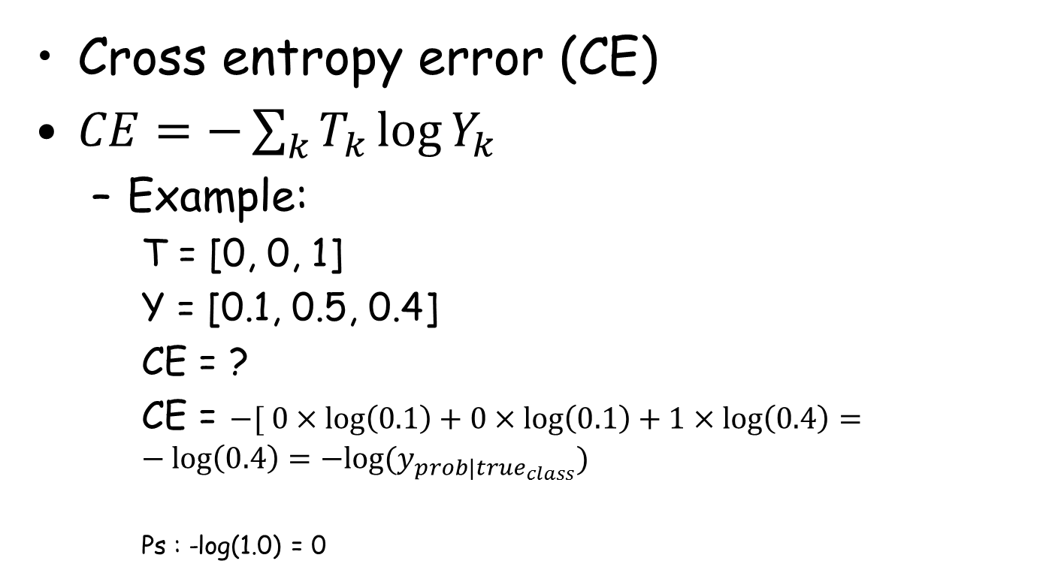
Loss function
Cross entropy error (CE)
$CE=−\sum_{k}{T_{k}\log{Y_{k}}}$
Example:
T = [0, 0, 1]
Y = [0.1, 0.5, 0.4]
CE = ?
CE = $−[ 0×\log\left(0.1\right)+0×\log\left(0.1\right)+1×\log\left(0.4\right)=−log\left(0.4\right)=−log(y_{prob|true_{class}})$
Ps : -log(1.0) = 0

Slide 10
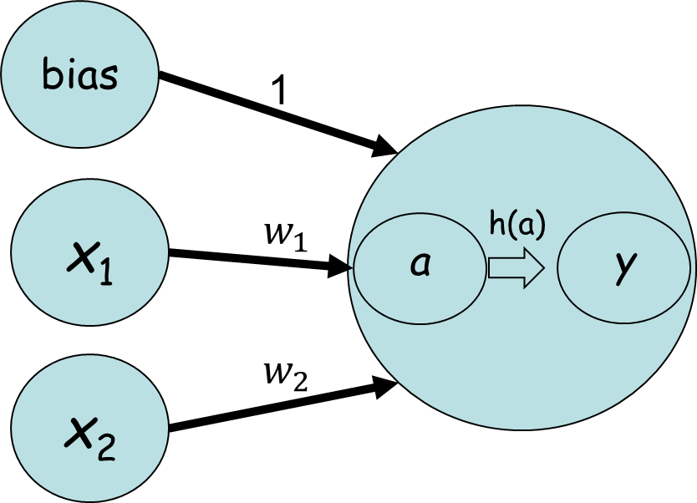
Training
Weights
? | ? | ?
? | ? | ?
? | ? | ?
Update
Back Propagation
Loss
Forward Propagation

Slide 11
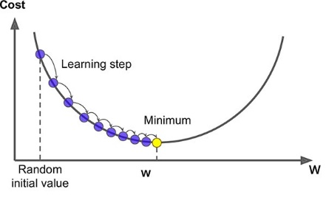
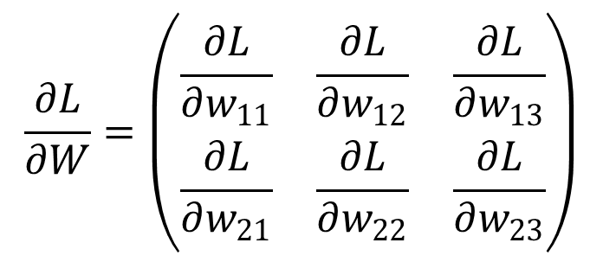
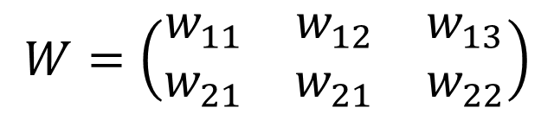
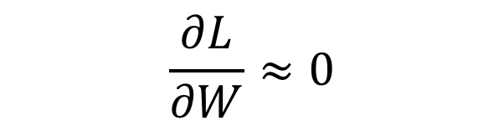
Back Propagation
$$W=\left(\begin{matrix}w_{11} & w_{12} & w_{13} \\ w_{21} & w_{21} & w_{22}\end{matrix}\right)$$
$$\frac{∂L}{∂W}≈0$$
$$\frac{∂L}{∂W}=\left(\begin{matrix}\frac{∂L}{∂w_{11}} & \frac{∂L}{∂w_{12}} & \frac{∂L}{∂w_{13}} \\ \frac{∂L}{∂w_{21}} & \frac{∂L}{∂w_{22}} & \frac{∂L}{∂w_{23}}\end{matrix}\right)$$
Notes:
https://medium.com/@14prakash/back-propagation-is-very-simple-who-made-it-complicated-97b794c97e5c

Slide 12
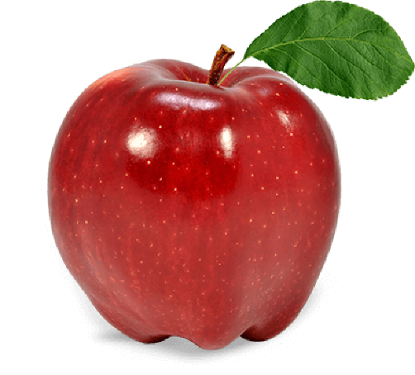
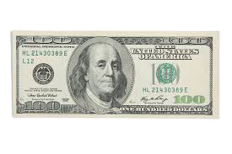
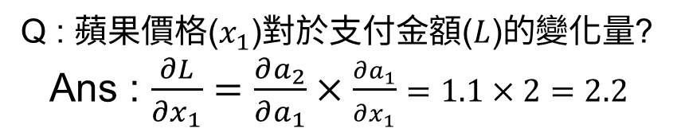
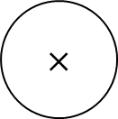
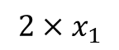
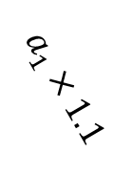
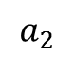
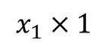
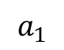
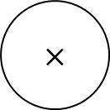
Computational graph
$$a_{1}$$
$$a_{2}$$
$$x_{1}×1$$
$$×$$
$$2×x_{1}$$
$$×$$
2.2
1.1
$$a_{1}×1.1$$
2
1
數量
1.1
Q : 蘋果價格($x_{1}$)對於支付金額($L$)的變化量?
Ans : $\frac{∂L}{∂x_{1}}=\frac{∂a_{2}}{∂a_{1}}×\frac{∂a_{1}}{∂x_{1}}=1.1×2=2.2$
營業稅
期望支付金額($L$)越低則$x_{1}$↓；蘋果降低1元則對於最終價格降低2.2元。

Slide 13
Training
Weights
? | ? | ?
? | ? | ?
? | ? | ?
Update
Back Propagation
Loss
Forward Propagation

Slide 14
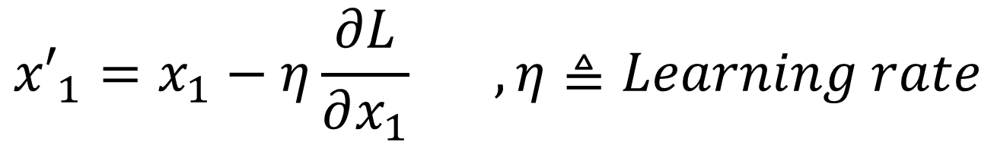
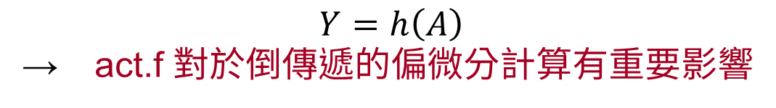
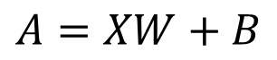
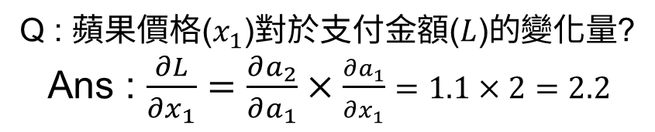
Update: Gradient descent method
$${x′}_{1}=x_{1}−η\frac{∂L}{∂x_{1}} ,η≜Learning rate$$
$$A=XW+B$$
$$Y=h\left(A\right)$$
→ act.f 對於倒傳遞的偏微分計算有重要影響
Q : 蘋果價格($x_{1}$)對於支付金額($L$)的變化量?
Ans : $\frac{∂L}{∂x_{1}}=\frac{∂a_{2}}{∂a_{1}}×\frac{∂a_{1}}{∂x_{1}}=1.1×2=2.2$
期望支付金額($L$)越低則$x_{1}$↓；蘋果降低1元則對於最終價格降低2.2元。

Slide 15
Review
Weights
? | ? | ?
? | ? | ?
? | ? | ?
Update
Back Propagation
Loss
Forward Propagation

Slide 16
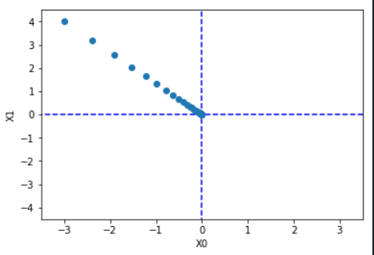
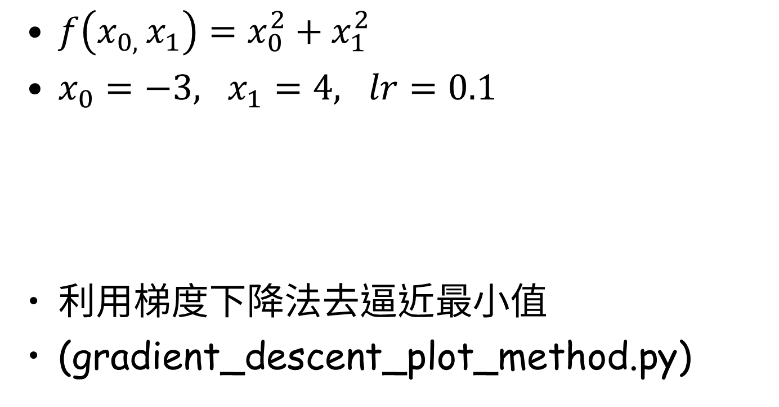
Exercises 1
$f\left(x_{0, }x_{1}\right)=x_{0}^{2}+x_{1}^{2}$
$x_{0}=−3, x_{1}=4, lr=0.1$
利用梯度下降法去逼近最小值
(gradient_descent_plot_method.py)

Slide 17
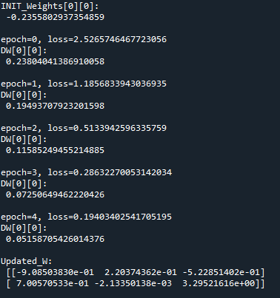
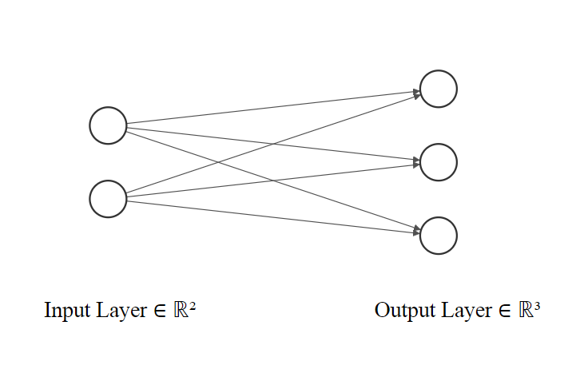
Exercises 2
Input = [ 0.6, 0.9 ]
Label = [0, 0, 1]
Learning rate = 1.0
Epochs = 5
W : Random
Activation = softmax()
Cross Entropy error
(gradient_simplenet.py)
Notes:
https://github.com/ashishpatel26/Tools-to-Design-or-Visualize-Architecture-of-Neural-Network

Slide 18
Midterm exam : Image classification
Dataset : MNIST手寫辨識數據集
Category = 10
Tasks
使用Keras
資料前處理(one-hot)
建立ANN
訓練ANN
評估與使用ANN
學習目的 : 使用Keras
ANN_MNIST.py

Slide 19
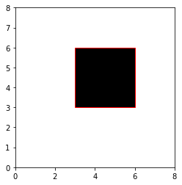
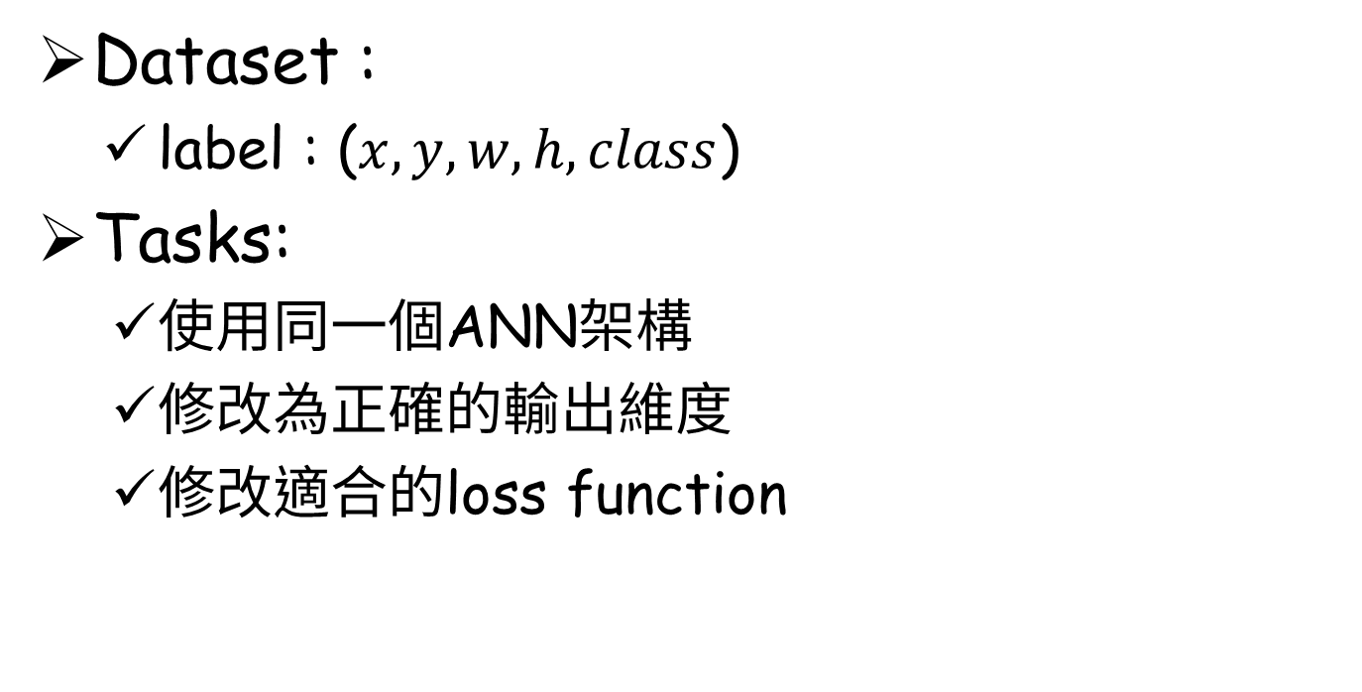
Midterm exam : Objective detection
Dataset :
label : ($x, y, w,h,class$)
Tasks:
使用同一個ANN架構
修改為正確的輸出維度
修改適合的loss function
學習目的: 神經網路具有泛用性
ANN_ObjectiveDetection.py

Slide 20
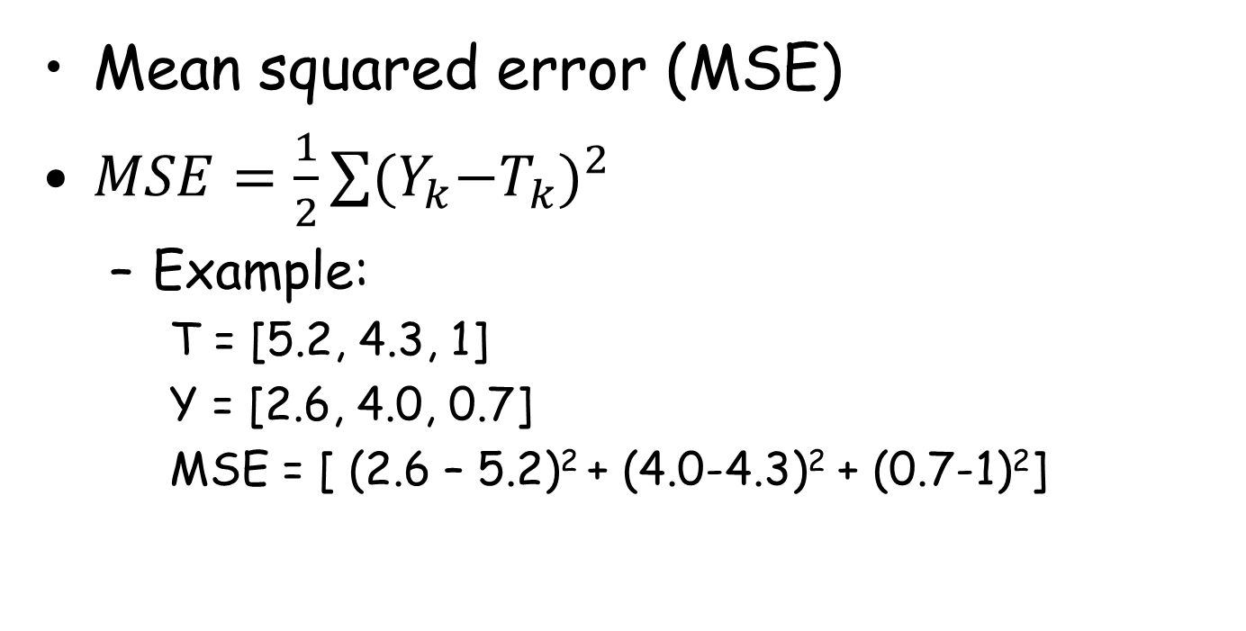
Loss function
Mean squared error (MSE)
$MSE=\frac{1}{2}\sum{{{(Y}_{k}−T_{k})}^{2}}$
Example:
T = [5.2, 4.3, 1]
Y = [2.6, 4.0, 0.7]
MSE = [ (2.6 – 5.2)² + (4.0-4.3)² + (0.7-1)²]

Slide 21
Conclusion of ANN
NN的正向傳播與反向傳播
Activation
Loss function
Gradient descent method

Slide 22
Convolutional Neural Network

Slide 23
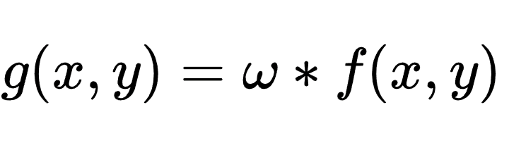

Spatial filter
where
g(x,y) 是濾波後的影像
f(x,y) 是原始影像
ω是遮罩(mask)
* 表示卷積運算
x
y = ω dot x
y = h(y)
ω
y
1. ω通常是>1的奇數方陣
2.Q&A: Why Border?
單純是否考慮原始影像的最外圍資訊，多擴無益。
Notes:
解釋ANN與CNN的差別以及CNN的優勢

Slide 24
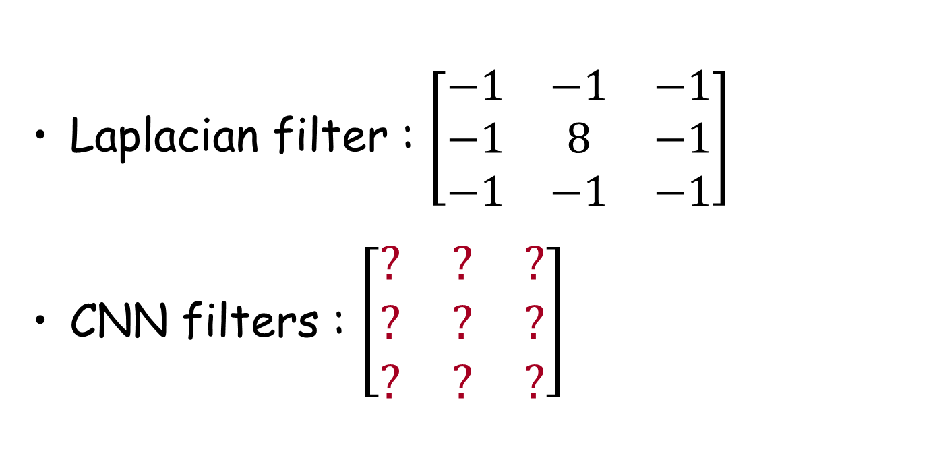
Weights in CNN
Laplacian filter : $\left[\begin{matrix}−1 & −1 & −1 \\ −1 & 8 & −1 \\ −1 & −1 & −1\end{matrix}\right]$
CNN filters : $\left[\begin{matrix}? & ? & ? \\ ? & ? & ? \\ ? & ? & ?\end{matrix}\right]$

Slide 25
CNN vs ANN
Why CNN?
ANN:
Mnist (28x28x1=784) → W_{784xh1}
CIFAR-10 (32x32x3=3072) → W_{3071xh1}
320x320x3=307200 → W_{307200xh1}
CNN:
Mnist (28x28x1=784) → W_{3x3}
CIFAR-10 (32x32x3=3072) → W_{3x3}
320x320x3=307200 → W_{3x3}
Notes:
局部性質(局部連接) : 一次只關注mask size個點資訊

Slide 26
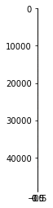

CNN vs ANN
ANN破壞空間資訊
CNN減少參數量
CNN具有局部性質
避免過擬合(overfitting)
(遮罩只觀測局部資訊)
整張影像共享權重(1個遮罩)

Slide 27
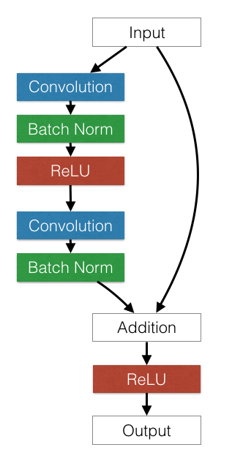
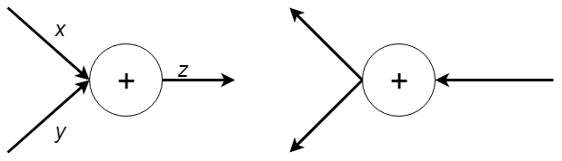
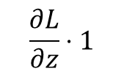
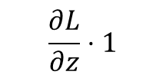
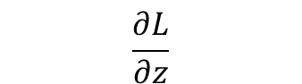
Recent Model
AlexNet、VGG16
ResNet
針對深度(解決梯度消失)
Resnet1024
$$\frac{∂L}{∂z}⋅1$$
$$\frac{∂L}{∂z}$$
$$\frac{∂L}{∂z}⋅1$$

Slide 28
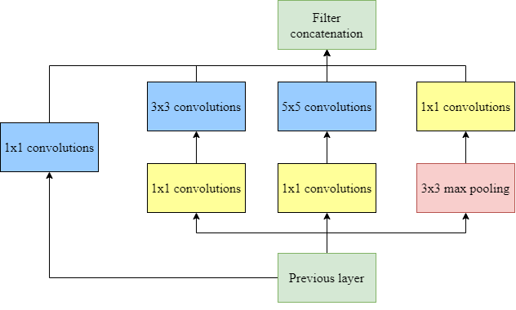
Recent Model
GoogleLeNet (加寬)
針對遮罩
Inception

Slide 29
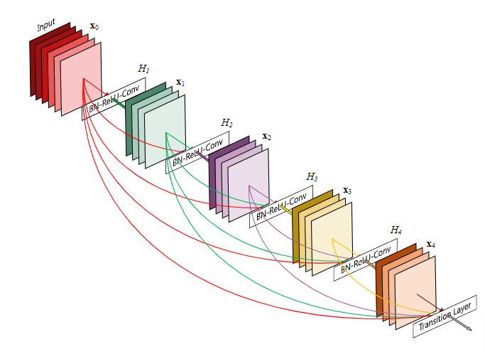
Recent Model
DenseNet
針對特徵

Slide 30

Recent Model
XceptionNet (Extreme Inception)
利用1x1遮罩針對空間

Slide 31




Recent Model
NSGA-Net (結構搜尋)

Slide 32

Recent Model
EfficientNet
^w^

Slide 33





Midterm exam : Generator
Dataset : 神奇寶貝分類
Category = 5
Tasks
MNIST是將所有的數據讀取進來
但事實上可能會遇到30G的數據
Generator : “用多少讀多少”
generator/train.py

Slide 34

Midterm exam : Objective detection
Dataset :
label : ($x, y, w,h,class$)
Tasks:
使用Conv2D取代Dense
學習目的: 參數更少，loss更低
ANN_ObjectiveDetection.py

Slide 35
YOLOv3 (You Only Look Once)

Slide 36


物件檢測兩大流派
Segmentation
Bounding Box

Slide 37


Grid Cells and Anchors

Slide 38

255 = [ (x, y, w, h, c) + Prob_{80 classes} ]x3

Slide 39


Feature Pyramid Network
增加特徵多樣性

Slide 40
Demo

Slide 41

Tiny YOLOv3
Prepare yolo_video.py
Anaconda Prompt.exe
activate {env_name}
“activate xxxBEANSTARxxx”

Slide 42
Tiny YOLOv3
Prepare yolo_video.py
cd /d {path of convert.py}
“D:\WorkSoftware\Python\BEANSTAR\tiny_yolo\keras-yolo3-master”

Slide 43
Tiny YOLOv3
Prepare yolo_video.py
python yolo_video.py --image
h1.png
h2.jpg
^w^

Slide 44
Custom Training

Slide 45


Tiny YOLOv3
Prepare Data
Label:
(x, y, w, h, class)

Slide 46

Tiny YOLOv3
Prepare Data
Format : PASCAL VOC
(x_{min}, y_{min}, x_{max}, y_{max}, class)

Slide 47

Tiny YOLOv3
Prepare Anchors (kmeans.py)
Yolo_anchors.txt

Slide 48

Tiny YOLOv3
Prepare yolov3-tiny.cfg (Notepad++)

Slide 49
Tiny YOLOv3
Prepare {name}.h5 (convert.py)
Anaconda Prompt.exe
activate {env_name}
“activate xxxBEANSTARxxx”

Slide 50
Tiny YOLOv3
Prepare {name}.h5 (convert.py)
cd /d {path of convert.py}
“D:\WorkSoftware\Python\BEANSTAR\tiny_yolo\keras-yolo3-master”

Slide 51

Tiny YOLOv3
Prepare {name}.h5 (convert.py)
python convert.py yolov3-tiny.cfg yolov3-tiny.weights raccoon.h5
^w^

Slide 52
Tiny YOLOv3
Ttaining (train.py)

Slide 53


Extra

Slide 54

Thanks for your attention

